Slide 1
ClimbCode

Slide 2

Our Path Today
The Workgroup
Idea & MVP
Business and costs
Work Methodology
2

Slide 3
The Workgroup

Slide 4
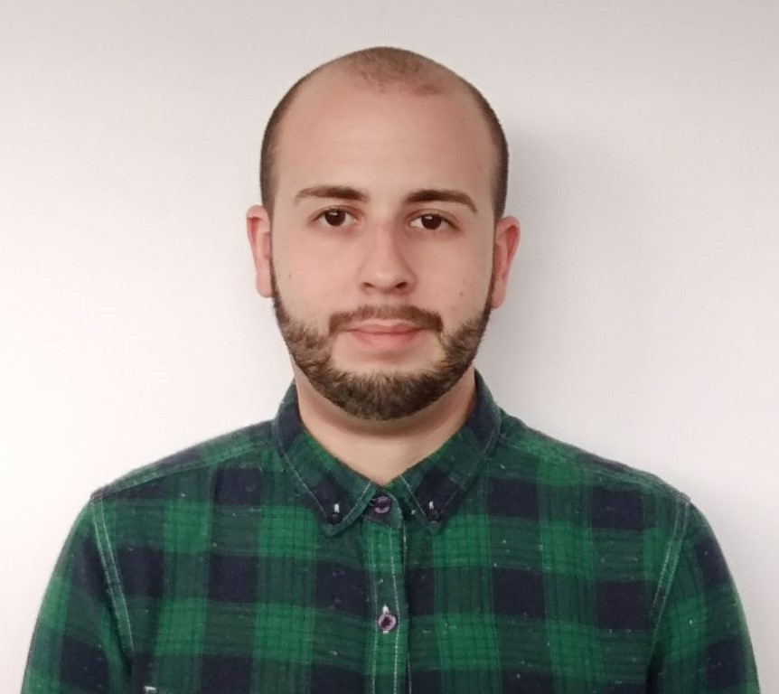

The Workgroup
Miguel Ángel Baños Carretón: Software Engineer
Álvaro Domínguez Núñez: Business Manager
4

Slide 5
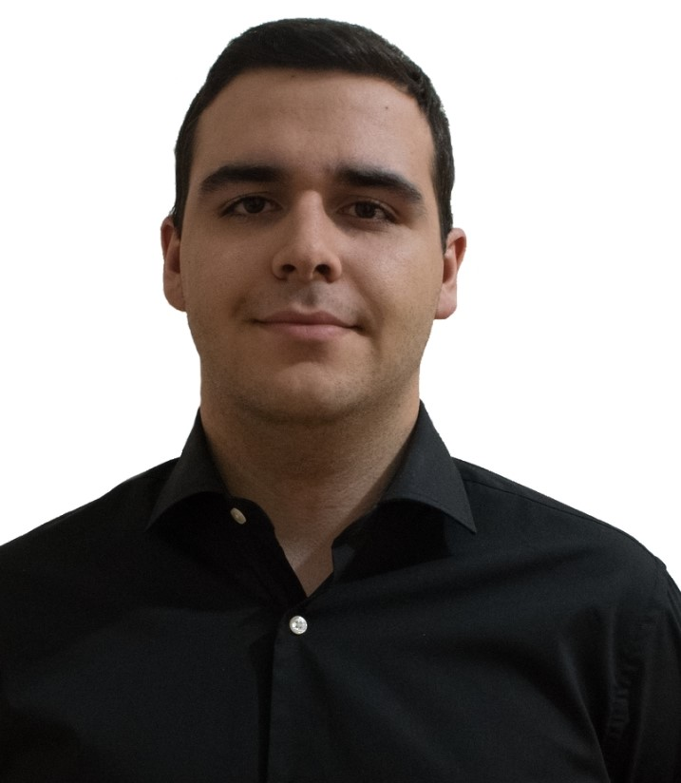
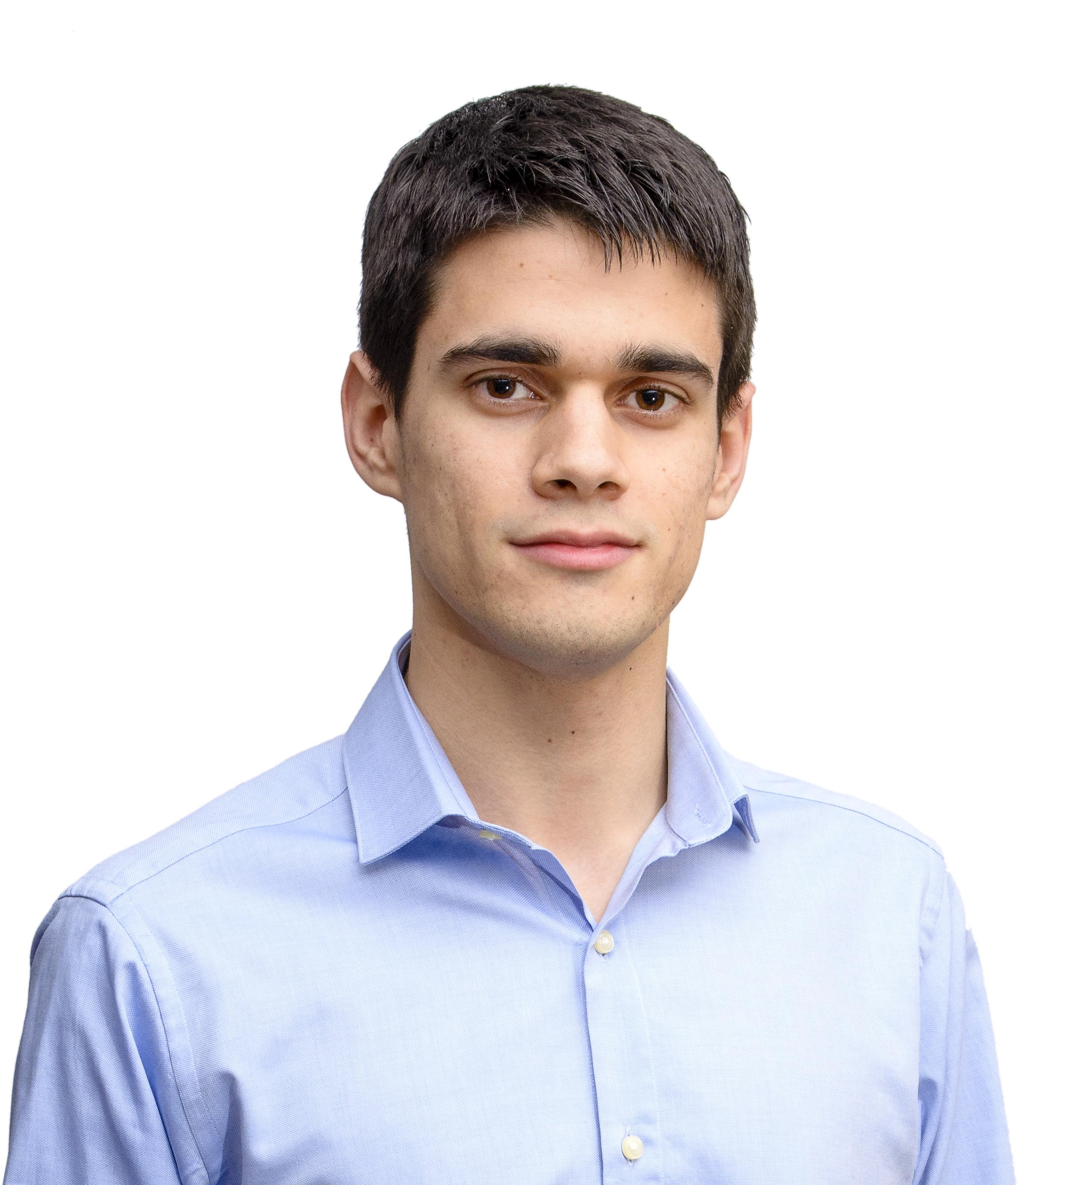
The Workgroup
Andrés Fernández Alés: Software Engineer
Alejandro Garrido Resina: Software Engineer
5

Slide 6
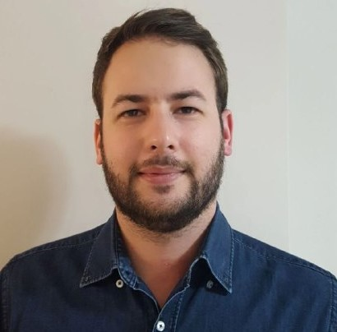
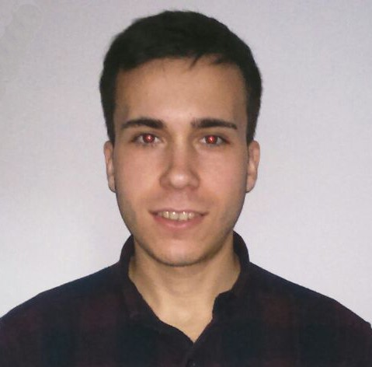
The Workgroup
Alejandro Román Rodríguez:
Project Manager
Álvaro Sánchez López: Software Engineer
6

Slide 7
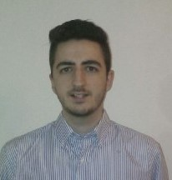

The Workgroup
Jesús Sosa Sánchez: Software Engineer
7

Slide 8
Idea & MVP

Slide 9
MVP & Idea
=
+
ClimbCode
9

Slide 10


MVP & Idea
=
+
9

Slide 11

Learn Programming?
14

Slide 12
14

Slide 13


MVP & Idea
Administrator:
10

Slide 14
MVP & Idea
School:
11

Slide 15

MVP & Idea
Teacher:
12

Slide 16
MVP & Idea
Student:
13

Slide 17
MVP & Idea
Programmer:
13

Slide 18
Let’s have a look
14

Slide 19
15

Slide 20
16

Slide 21
17

Slide 22
18

Slide 23
MVP & Idea
DAFO:
19

Slide 24
Business and Costs

Slide 25
Education
29

Slide 26




Business and Costs
31

Slide 27
Is it worth it?
30

Slide 28
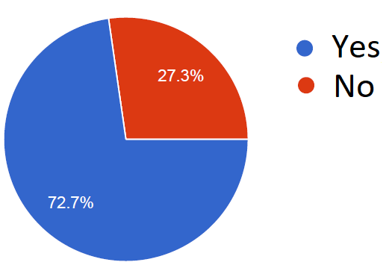
Business and Costs
From 88 people: Related to teaching
31

Slide 29
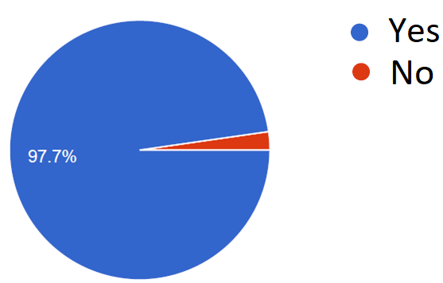
Business and Costs
From 88 people: Thoughts about programming
32

Slide 30
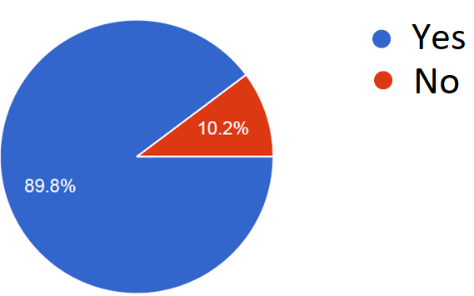
Business and Costs
From 88 people: Want a tool for programming at school
33

Slide 31
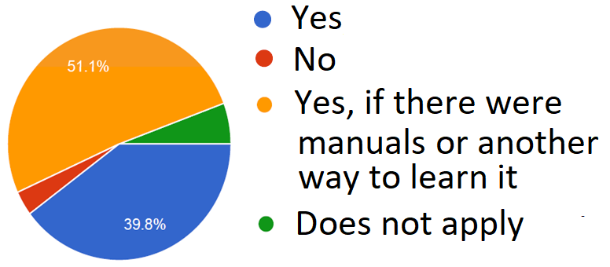
Business and Costs
From 88 people: Would use the tool
34

Slide 32
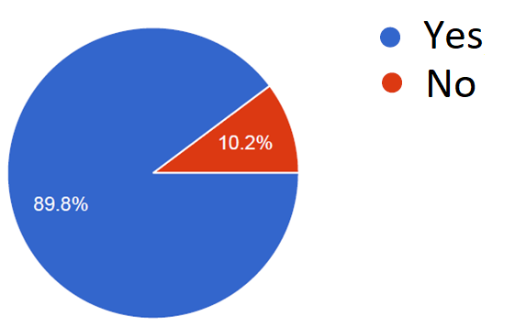
Business and Costs
From 88 people: Thoughts about students
35

Slide 33
How much?
36

Slide 34
Business and Costs
Direct Costs: 3721,4 €/m
Indirect Costs: 20,5 €/m
Amortizations: 816,62 €/m
37

Slide 35
Business and Costs
4540,52 €/m
22162,08 €
38

Slide 36
Business and Costs
38

Slide 37
Business and Costs
38

Slide 38
36

Slide 39

Business and Costs
39

Slide 40
Business and Costs
%
39

Slide 41
Work Methodology

Slide 42

Work Methodology
SCRUM: Three Sprints.
24

Slide 43

Work Methodology
Sprint 1:
25

Slide 44
Work Methodology
Future Sprints:
26

Slide 45



Work Methodology
Development:
27

Slide 46


Work Methodology
Knowledge:
27

Slide 47

THANKS!
You can find me at
alvdomnun@alum.us.es
40

